Slide 1
ACME ANVILS
Security Brief
Mitchell Tyrer - Director of IT
Matthew Dintrone - Security Engineer
Richard Brazzle - Security Engineer
Matthew Brossman - Security Engineer

Slide 2
01
02
03
04
PAST EVENTS
THE NETWORK
SYSTEMS
GET PREPARED
Analysis of Recent Security Event
Observations of ACME’s Network
Vulnerabilities of ACME Desktop Assets
How to prepare to deal with future events

Slide 3
Past Events
01
Observation from the recent Data Breach

Slide 4
The Data Breach
Several Weeks ago there was a major data breach into ACME Anvil’s network. These major security breaches are a major issue for any organization, and are occurring more and more frequently.
In order to help rebuild ACME’s reputation amongst customers and partners, we must use this data breach as a learning experience to increase ACME’s overall security posture.

Slide 5
How it Happened?
Analyzing the logs over the last month we noted several attack vectors and exploits that may have been used by the attackers. Some of which are known vulnerabilities. These include:
From ACME’s Intrusion Detection System (IDS)
Evidence of spyware detected
Evidence of a ping sweep or port scan
Unknown External and Outbound Connections via SSH and FTP
Failed IPv6 message connections to other workstations
From ACME’s Firewall
Evidence of HTTP Header Injection leading to possible Cross-Site Scripting
Cross-Site Scripting on the Outlook Web Access (OWA) client
Evidence of Directory Traversal
Evidence of a GET request Buffer Overflow on the SENKAS Kolibri Web Server 2.0.
Evidence of the execution of Shell Code

Slide 6
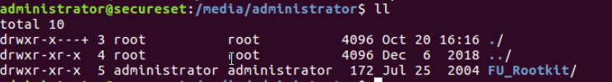
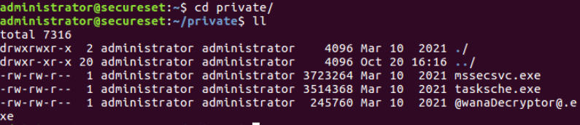
Once exploited it appears that the attackers utilized the FU Rootkit - a kernel based malicious software that allowed for persistent privileged access that can change kernel data structures to hide itself.
There was also evidence in a directory name /private of a possible future ransomware attack using the WannaCry Ransomware.

Slide 7
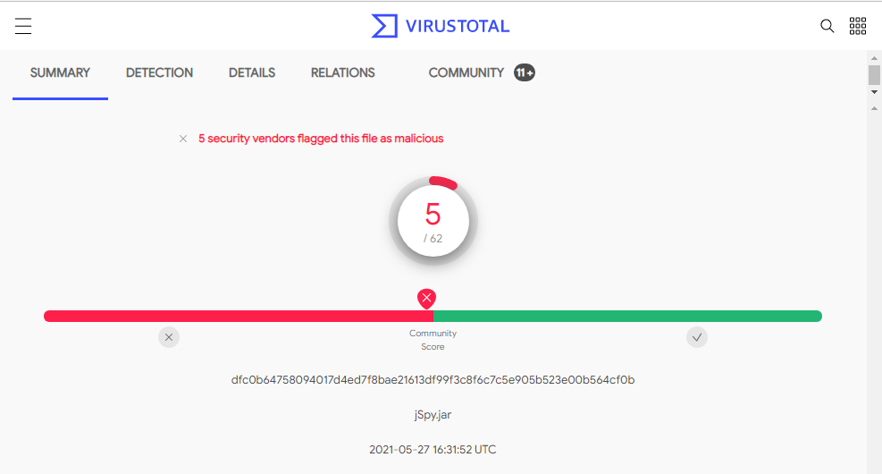
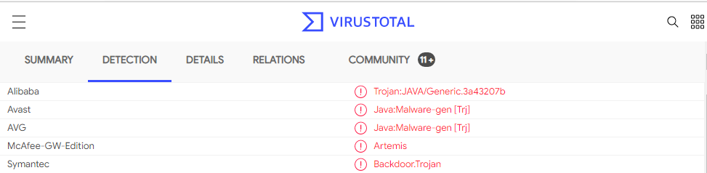
Additional investigation into our endpoints we discovered some suspicious files in the downloads folder of our Windows10 Machines. These files also appeared on the SMB file share (which may have been how they were distributed).
According to virustotal the file jSpy.jar is a malicious file flagged as a Trojan and potential backdoor.

Slide 8
Immediate Remediations
The presence of a rootkit means that attackers will have constant privileged access to the system. This is critical security risk and must be dealt with quickly.
Unfortunately the only true way to make sure that a rootkit or backdoor is completely removed from a system is to reformat the hard drive and reinstall the operating system. This means that to secure our network we must:
Immediately Remove the infected system from the network and isolate it
If necessary, only backup important documents and datafiles to a CD or Tape. External drives may become compromised by the rootkit simply by being plugged in
Avoid backing up any scripts, executables, and compressed files, as these could also be compromised.
Once all files are backed up safely, and confirmed to not be corrupted, complete reformatting of the drive is recommended.
Install a fresh operating system and bring it back to a secure baseline before reconnecting to the network.

Slide 9
Further Recommendations
Based on our observations here are some immediate remediations to prevent these attack vectors from being utilized in the future.
Audit Firewall rules to deny unwanted traffic instead of just monitor it
Implement Host Based Anti Spyware/Malware Software
Disable outbound ICMP traffic to limit external visibility
Use secured versions of vulnerable protocols
Example: If FTP is necessary for ACME operations, use SFTP instead
Change default ports
Implement input validation and sanitation on web applications and their APIs/Databases
Make sure all utilized software and applications are up to date
Update Microsoft Exchange Server hosting the OWA to at least version 5.5 Service Pack 4
Update SENKAS Kolibri Server to newest version
Avoid copying user controlled data into HTTP response headers.

Slide 10
Monitoring Security Events
01.1
To help with prevention, we need to properly monitor our network

Slide 11
Monitoring Logs
To properly respond to these events in the future, we need to implement a means to monitor our entire network. The best way to do this is to collect, securely store, and regularly analyze logs across the network. These logs should include:
System Logs
Agent Based/Endpoint logs
Physical Security Logs
Application logs
Networking Logs
Email
Firewalls
Technical Logs
HTTP logs
DNS, DHCP, and FTP Logs
Server Logs
Logs from Monitoring tools
Logs from Malware Protection
IDS/IPS
Other Relevant security management appliances and tools
A minimum estimate of necessary additional data storage would be approx. 8TB annually

Slide 12
Metrics to Monitor
We should also begin monitoring several metrics on our network to help detect anomalous activity. As well as produce measurable data to share with the Board of Directors to help with decision making.
Bandwidth Consumption
Retransmission
Open Connections
Open Ports
IP Address Conflicts
Detected Intrusion Attempts
Vulnerability Data
Number of Users
Incident Rates
Overall Data Generation

Slide 13
Security Information and Event Management (SIEM)
To assist us with monitoring this tool will allow us to set up immediate ways to alert us of certain activity, create easy to read visualizations of data for analysis, and schedule reports as needed to be automatically generated.
There are several options on the market for these tools. The two that we suggest for consideration are Elasticsearch or Splunk.
Elasticsearch:
Open source search and analytics solution
Would still require purchase of storage space for all the logs generated by ACME for monitoring.
Would require team to build entire solution themselves from the ground up.
Splunk:
Commercial Solution
Scalable, easier to deploy, Vendor Support, additional plugins
More expensive solution
Estimated annual cost of a perpetual license is $1,500 for 100GB per day

Slide 14
The Network
02
Mapping and Inventory of ACME’s current network.

Slide 15
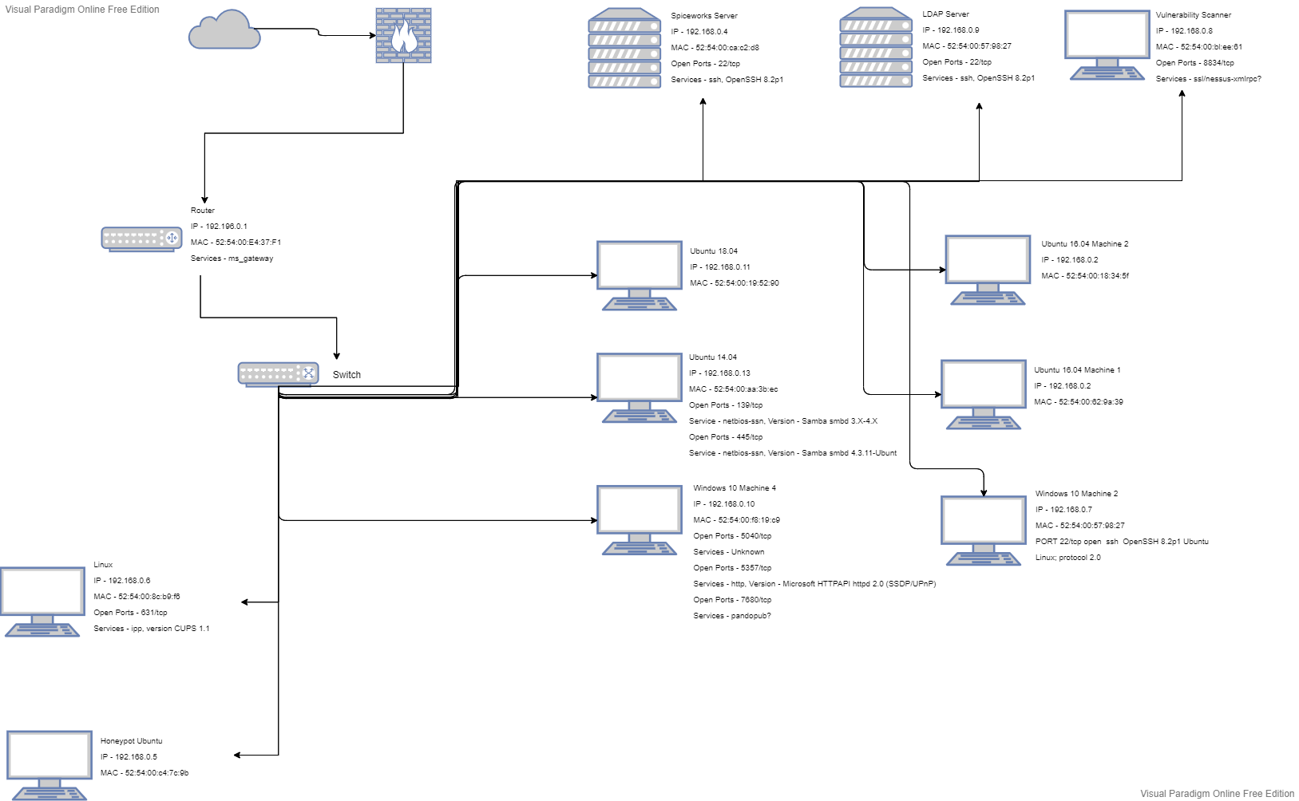
The Current Network
In order to secure the network properly, we must first know what is on the network. To do this we did several scans using Nmap to discover hosts and other information about them to construct a network diagram.

Slide 16
Our Findings
Honeypot and Test Machine (Linux) are vulnerable machines that should be placed in their own subnets..
Public Facing systems/servers should be placed into a DMZ
Introduction of additional internal firewalls to help monitor and control access to segmented networks.
No differentiation between departments. Essentially, the Developers should not have access to sensitive data that should only be available to the Sales Department.

Slide 17
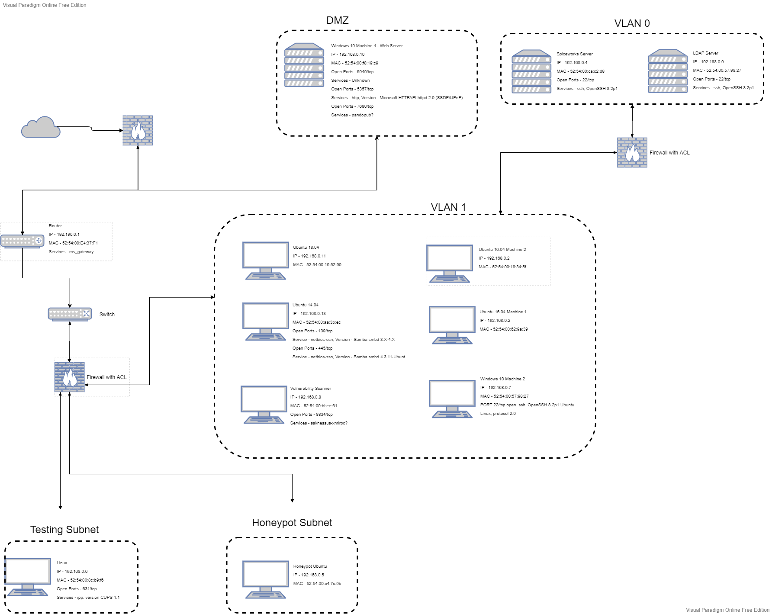
Recommendations
Based on our findings, we built an updated network diagram for how we would like to begin to harden the network. This assumes that the need for individual department subnets in not required.

Slide 18
Other Network Hardening Procedures
Aside from creating separate subnets and implementing additional firewalls and keeping up to date auditing rules for them and our IDS there are other things we can do to harden our network security
Change Default Passwords
Encrypt all incoming and outgoing network traffic
Disable unused services and keep required services up to date and are the secure versions of protocols
Close all unused ports
Audit Network Privilege access regularly

Slide 19
Honeypot
02.1
Configuring our Honeypot in order to fight back.

Slide 20
Why Use a Honeypot?
In the network mapping, we see that ACME already has a honeypot on it’s system. This is a useful tool when utilized properly because:
It is a controlled and safe environment allowing the security team to analyze different threats.
Allows Security Team to focus 100% on the threat and not be distracted by standard real network traffic.
As a lucrative target, this can distract attackers from the real network.
Attacks on the honeypot will help the Security Team to be able to defend the actual network

Slide 21
Current Resources
Utilizing our current honeypot correctly:
Requires altering its location to a less impactful area of the network
Requires personnel to be assigned to managing and monitoring the honeypot
May require hiring
Set up the honeypot to use an administrator account with no password, or with a default password. This makes it easy for the attacker to escalate their privileges.
Configure the honeypot to run unnecessary services and leave ports open to give the attackers several avenues to access the computer
Include decoy files or databases that mimic the data your organization actually keeps on file. An example of this might be a SQL database that includes customer PII and PCI.
Mimic the look and feel of other computers on the network to evade detection from the attacker.
Employ stealthy and tamper-resistant monitoring methods to gather information on attacks and attackers

Slide 22
Possible Upgrades
Deploying a new honeypot solution:
Open Source solutions available;
Honeytrap, cowrie, Delilah, ESpot
Requires personnel to be assigned to managing and monitoring the honeypot
May require hiring
Commercial solutions available
Acalvio ShadowPlex, Bad Packets, Illusive Networks, Smokescreen Illusion Black
Generally centrally managed
Does not require hiring

Slide 23
Server Hardening
02.2
Protecting our Web Server

Slide 24
Web Server Risks
Based on the examination of the logs from the recent attack, it is clear that there are several misconfigurations and bugs in ACME’s Web Servers. These misconfigurations and bugs could allow attackers to:
Steal confidential documents not intended for their eyes.
Execute commands on the server host machine, allowing them to modify the system.
Gain information about the Web server's host machine that will allow them to break into the system.
Launch denial-of-service attacks, rendering the machine temporarily unusable.

Slide 25
Recommendations
Overall, as we move forward with strengthening our security posture, we will need to implement several hardening solutions.
Install Web Application Firewall Software
Implement Distributed Denial-of-Service Attack Protection
Free DDOS protection tools
Webroot DNS Protection.
Nginx.
DataDome.
BitNinja.
HAProxy.
Reblaze.
DDoS-GUARD
Use SFTP Instead of FTP
Back-Up Data on Servers
SSL/TLS Connections
Antivirus and Antimalware Protections
Remove Unused Applications Not Used for Hosting
Configure the Host’s HTTP Strict Transport Security (HSTS) Header

Slide 26
Commercial Options for Web Security
Commercial products such as Barracuda or UPTRENDS makes it simple for businesses to protect the web servers.
UPTRENDS
Real User Monitoring (Passive)
View actual user’s experience and collect and quantify website performance and user data directly from applications site’s visitors with Real User Monitoring (RUM).
View geographical distribution of users and their load times.
Analyze the exact breakdown (network, backend, and frontend) of load times experienced by your real users.
Synthetic Monitoring (Active)
Validate if your site is up in a proactive fashion.
Test website functions and predictive click paths to be notified when something breaks before your users do.
Analyze the root cause of load time spikes with rich waterfall reports on an element level.
Uptrends is ISO 27001 certified. ISO 27001 is a standardized management approach for the ongoing security and control of sensitive information.
Barracuda
Enforce Corporate Policies and Monitor Network and User Activity
Increase productivity, regulate bandwidth usage, and prevent risky behavior by enforcing granular policies on user activities.
The Barracuda Web Security Gateway can control access to web sites, applications, and Web 2.0 platforms Protect Against Web-Based Threats
Keep networks and users safe by blocking spyware downloads, preventing viruses, and restricting requests to malicious websites
Gain complete insight into user activity and network threats via an intuitive dashboard and integrated reporting. This clear visibility lets administrators create effective policies and generate proactive alerts to properly respond to threats.
The Barracuda Reporting Server is a powerful platform that enables unified reporting for Barracuda Web Security Gateways.
Barracuda Reporting Server generates accurate, customizable reports in a fraction of the time that it takes built-in reporting engines
***Price of service is dependent on evaluation of the Company’s current network layout and security needs***

Slide 27
Systems
03
Observations of the current configuration of ACME Systems

Slide 28
Vulnerability Scan
ACME already has a vulnerability scanner at its disposal in the form of Tenable Nessus.
Utilizing this scanner we created a priority list of current vulnerabilities on each host, and the remediations necessary.
These will be top priority remediations to begin strengthening our overall security.

Slide 29
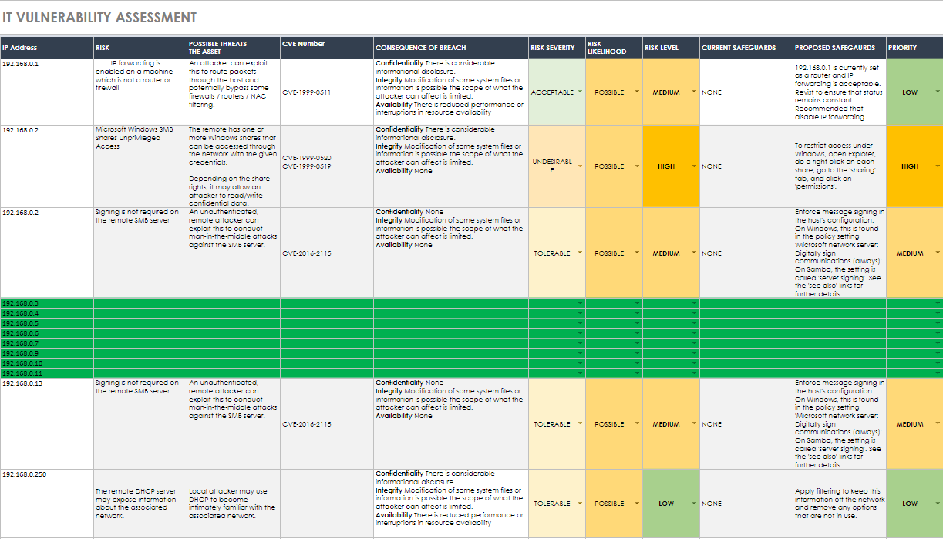

Slide 30
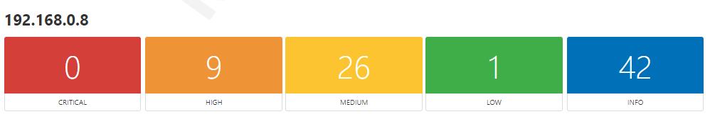
192.168.0.8
This machine, which hosts the Nessus Scanner, had a multitude of high and medium vulnerabilities. Because of this we created a separate table similar to above. However, the remediation for all of these is to update the system.

Slide 31
Recommendations
Overall, as we move forward with strengthening our security posture, we will need to implement several hardening solutions.
Organization Wide Hardening Solutions
Implement a centralized Patch Management System to keep all systems up to date with latest security patches. This will also allow for testing of patches before deployment.
Create a strong Password Policy across all systems.
Minimum 14 characters long
Use of special Characters [ !, &, @ … ]
At least one uppercase character
Implement a password history and expiration
Stored passwords should be sufficiently encrypted (hashed)
Enable Account locks after a number of failed logins
Create strong authentication policies
Possibly implement multi-factor authentication to prevent use of compromise of credentials
Remove/Disable all unnecessary/unapproved applications and services
Encrypt Data that is at rest.

Slide 32
HBSS
03.1
Implementing a Host Based Security System

Slide 33
What is an HBSS?
A Host Based Security System (HBSS) is the official term used by the U.S. Department of Defense for the suite of commercial off the shelf software used to monitor, detect, and defend computer networks and systems.
As commercial off the shelf implies, this is something commercially available to all businesses. It is however, a standard for all DoD Systems and Networks.
Most commonly this is a suite of security software developed by McAfee and Centrally Managed by their ePolicy Orchestrator.

Slide 34
Benefits and Challenges of an HBSS
PROS
CONS
Provides real time overview of security posture of desktop assets
Ability to scan all assets for compliance
Create a security benchmark across the organization and monitor changes
HIPS/Firewall and Virus Scanner
Ability to test policy updates before deployment
Streamlined Incident Investigation and Remediation
Detailed report capabilities
Requires additional resources to manage
Initial deployment could cause setbacks in day to day operations
May have integration issues with existing security program
Increase overall cost in the IT budget - this is due to training, additional manpower, infrastructure needs, and licensing

Slide 35
Other Options
Due to the cost that may be required to implement a complete HBSS solution, it may be better to look into other means to defend our workstations.
The simplest would be to utilize a basic Anti-Virus plan. There are several options to choose from:
McAfee
Norton
Crowdstrike
Malwarebytes
These services do offer enterprise level options. And may be cheaper. However, they do not offer the same centralized control of policies and may not scale up as well as an HBSS would.

Slide 36
Get Prepared
04
Creating an Incident Response Plan for the Future

Slide 37
“Success depends upon previous preparation, and without such preparation there is sure to be failure.”
— Confucius

Slide 38
Creating an Incident Response Plan
The purpose of an incident response plan is to lay out the policies and procedures for the organization in the event another incident does occur. It will include:
Establish Roles and Responsibilities
Identification, isolation, and repair of data breaches
Timing outlines to handle an incident
Outline the content of communications
Define required documents during the steps of the incident response.

Slide 39
The Incident Response Team
 | Name | Email | Work Phone | Mobile Phone
Manager | Mitchell Tyrer | m.tyrer@acme.com | 555-1234 | 562-5001
Technical Expert | Richard Brazzle | r.brazz@acme.com | 555-2345 | 903-5768
Technical Expert | Matthew Dintrone | m.dintrone@acme.com | 555-4321 | 809-0210
Technical Expert | Matthew Brossman | m.brossman@acme.com | 555-8765 | 313-2556
Communication Specialist | Jessica Rabbit | j.rabbit@acme.com | 555-0987 | 867-5309
Legal Consultant | Emma Webster | granny@acme.com | 555-6758 | 313-5983

Slide 40
Additional Members
Depending on the incident, additional experts may be required for the incident response team. These members will be added at the discretion of the Incident Response Manager depending on the incident.
For example, if the incident involves an Application developed by ACME, then it may be necessary to include a member of the development team during an incident.

Slide 41
Phases of Incident Response
PREPARATION
Annual Security Awareness Training; Create Governance Policies; Establish Logical Security Controls
DETECTION
Ability to Alert Security Teams to Anomalous Activity; Training for other employees to proper ticketing of anomalies.
ANALYSIS
Determine reality of possible threat; Determine the level of intervention required; Determine mitigation strategy and procedure
CONTAINMENT, ERADICATION, RECOVERY
Discover the origin of event; Isolate compromised systems; Begin remediation techniques and collection of evidence

Slide 42
After Incident Resolution
POST-INCIDENT ACTIVITIES
Review of the incident meeting conducted by IRM; Compile all documentation, evidence, and logs of the incident for the Incident Summary Report
LESSONS LEARNED
IRM will meet with ACME Administrators and discuss the event in detail; Determine appropriate actions needed to increase effectiveness of current Incident Response Policies and Procedures; Draft an Improvement Plan with Plans of Actions and Milestones

Slide 43
OSINT
04.1
Policy creation to reduce disclosure of information

Slide 44


Social Media and Personal Internet Usage Policy
Without clear guidelines regarding what employees can and cannot access, significant risk may be encountered.

Slide 45
Potential Hazards
Without clear cut guidelines, the organization runs the risk of the following attacks:
Phishing/Spear Phishing
These types of email-based (or social media messenger-based) attacks can be used to harvest credentials and gain access to company data.
Social Engineering
Attackers can manipulate publicly available data such as information posted on social media sites to exploit trust and attack the organization.
Web Application Attacks
Attackers exploit vulnerabilities in a web application’s code to execute their own code in a client’s browser, or to hijack a connection to a specific site.

Slide 46
Immediate Solution
Introduce a company-wide policy for social media use and personal use of the internet on corporate-owned devices, and for personal devices at work.
Develop policies to control access to the company network and what can be accessed on a given network.
Acceptable use policies for personal devices and company owned devices
Application whitelisting and blacklisting.
Create and disseminate guidelines for posting on social media about ACME.
Security Awareness training

Slide 47
Q&A
Any questions, Comments and Concerns

Slide 48


